Slide 1
Week 5 Update
Chris Kreienkamp and Daniel Fishbein
FollowerStopper/ACC

Slide 2
Abstract
Humans naturally cause traffic jams.
A steady velocity is the best alternative to traffic jams in congested driving.
FollowerStopper is a controller that gives an optimal velocity to a self-driving vehicle based on traffic conditions.
We want to prove that FollowerStopper will lessen traffic jams, optimize it to account for different traffic conditions, and prove that it is safe.
Notes:
Humans naturally cause traffic jams, even without traffic “triggers”. A steady velocity is the best alternative to traffic jams in congested driving.
FollowerStopper is a controller that gives an optimal velocity to a self-driving or ACC vehicle based on traffic conditions. FollowerStopper will avoid collisions by slowing down without hard braking.
We want to prove that FollowerStopper actually will lessen traffic jams and optimize it to account for different traffic conditions. We also want to prove that it is safe.

Slide 3
Week 4 Accomplishments
Literature reviewed:
”Full velocity difference model for a car-following theory”
“Experimental validation of connected automated vehicle design among human-driven vehicles
“Dissipation of stop-and-go waves via control of autonomous vehicles: Field experiments”
“Vehicle Dynamics Blockset: User’s Guide”
”Vehicle Dynamics Blockset: References”
“Heterogeneity, lane-changing, and instability in traffic: a mathematical approach.”
Completed actions:
Abandoned Gazebo and ROS
Gained a greater understanding of Simulink, MATLAB, and FollowerStopper
Recreated a Human Car-Following Model
Recreated 10 cars following each other

Slide 4
Topics of Interest
Human Car-Following Model
Simulations in Simulink

Slide 5
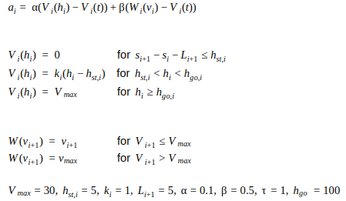
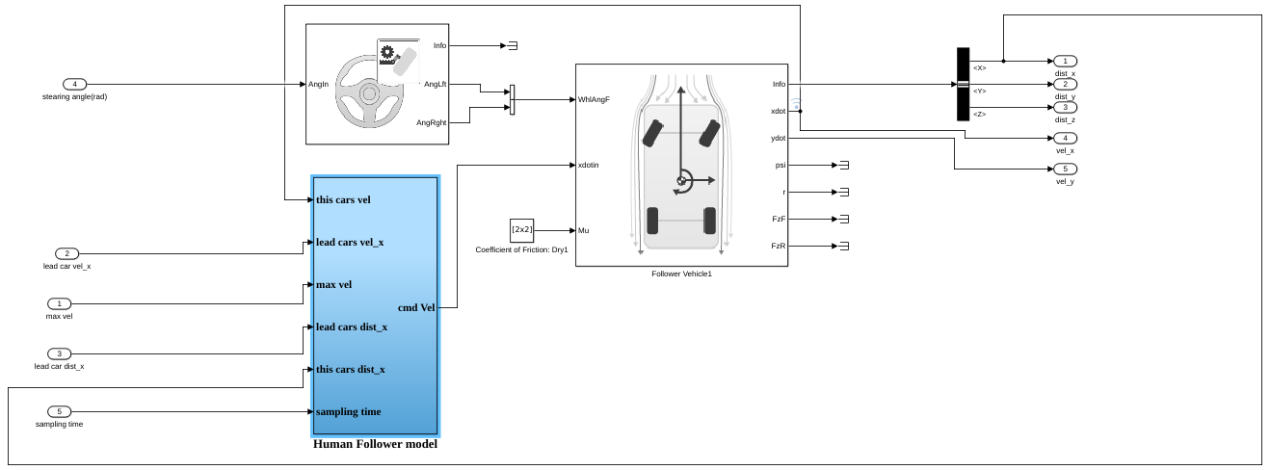
Human Car-Following Model
Our first human driver model (GeHF):
Math pic here
Simulink pic here:
Notes:
No values for constants for OVRV anywhere

Slide 6
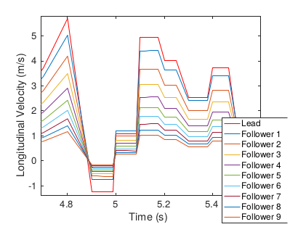
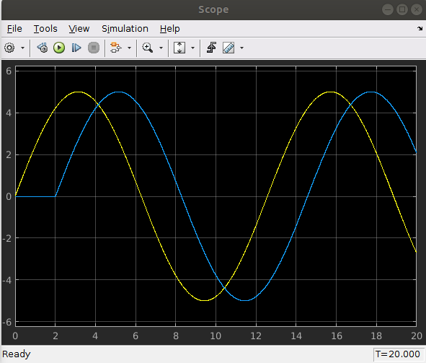
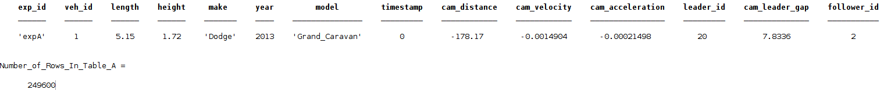
Human Car-Following Model Continued...
This is the problem:
It’s string stable.
We think it’s because The care has a 0 reaction time
We are also trying to simulate another human driver using data from the Ring Road Experiment
Pic of data here
Notes:
No values for constants for OVRV anywhere

Slide 7
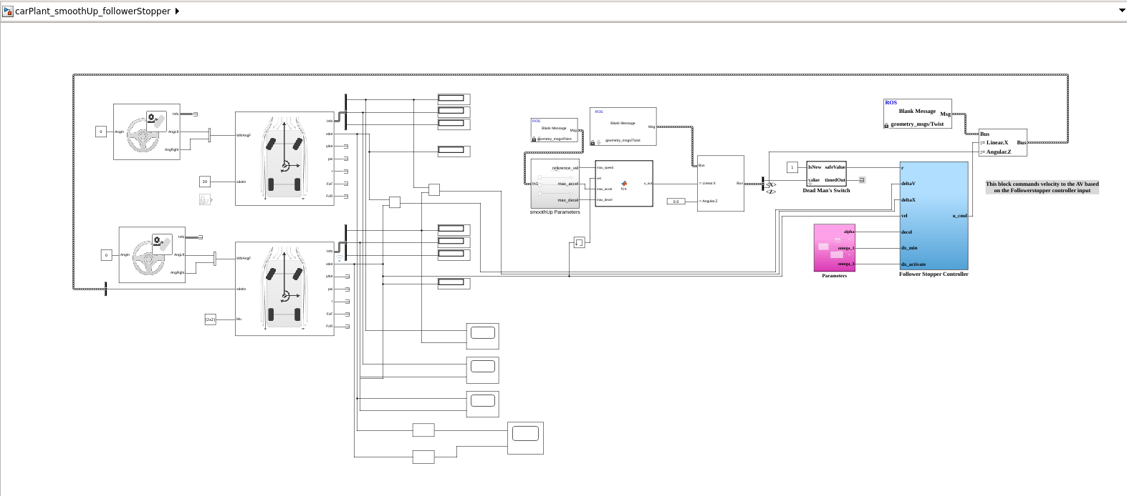
Simulations in Simulink
Problems:
Acceleration
Algebraic loop
Car Plant → SmoothUp Params → FollowerStopper
Car Plant → Car-Following Model

Slide 8
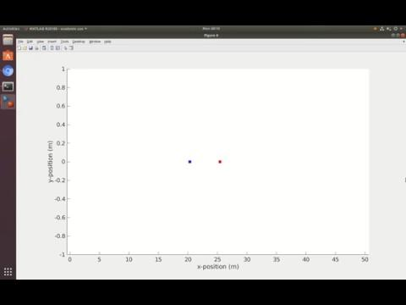

Simulations in Simulink
leaderRandom_followerStopper
leaderSine_followerStopper_10

Slide 9
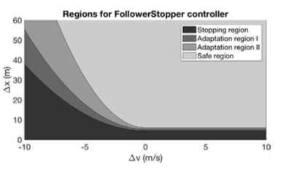
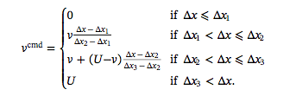

Weekly goals
Scenario One: Straight Line Model
Scenario Two: Ring-Road Model
All vehicles car-following for scenarios
All vehicles FollowerStopper for scenarios
Determining desired velocity (U)
Notes:
Scenario One: Straight Line Model
Lead car synthetic velocity
Some follower vehicles with car-following model
Some vehicle i has follower stopper
Some more following vehicles with car-following model
Scenario Two: Ring-Road Model
Model cars in perpetual traffic
One car is FollowerStopper, others are car-following
All vehicles car-following for scenarios one and two
All vehicles FollowerStopper for scenarios one and two
Desired velocity
Hand-tailored → expert’s advice
From global information

